Slide 1
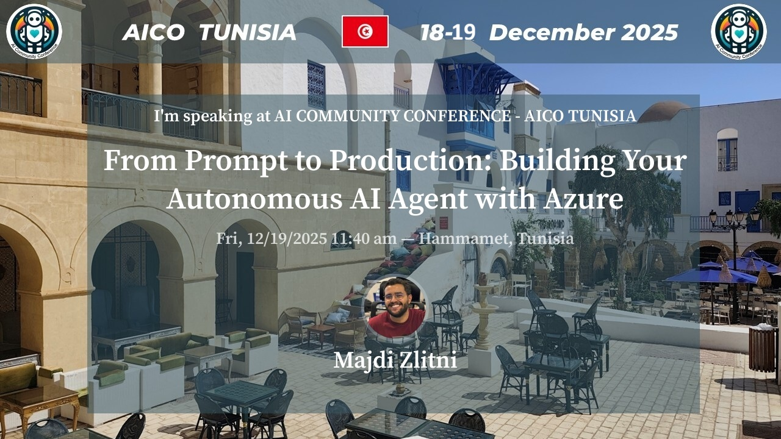

Slide 2
What if an AI agent can automate the testing for us?

Slide 3
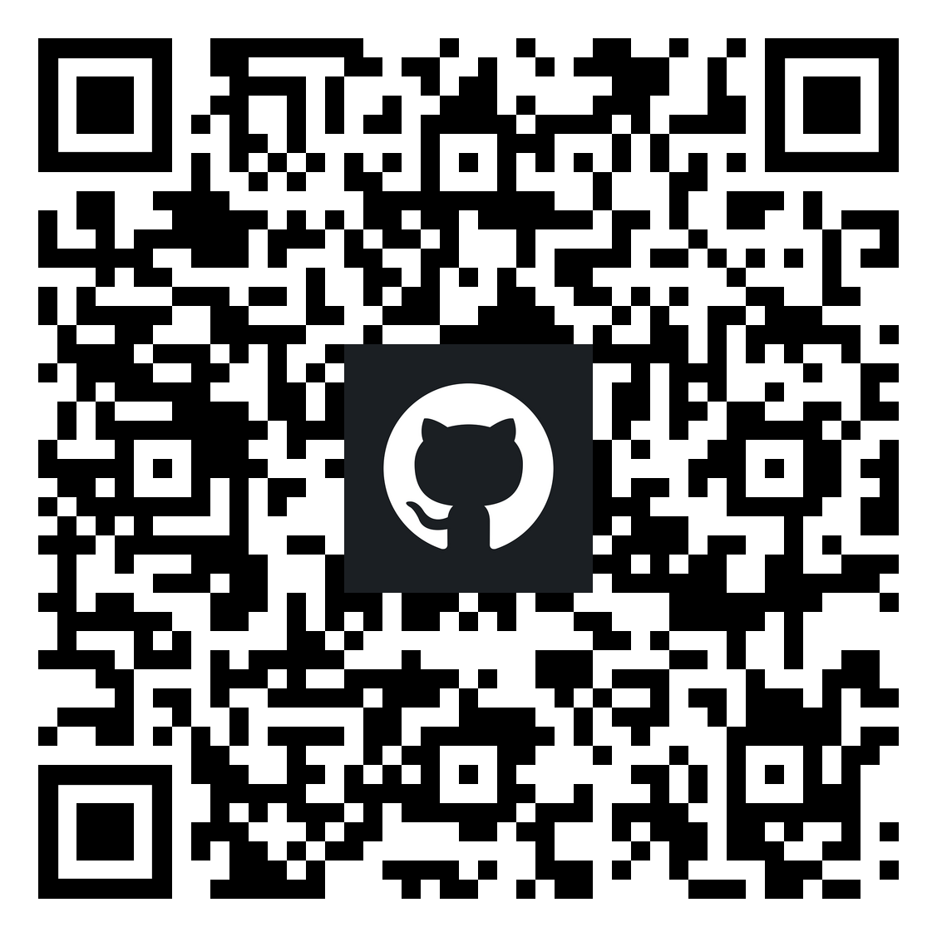

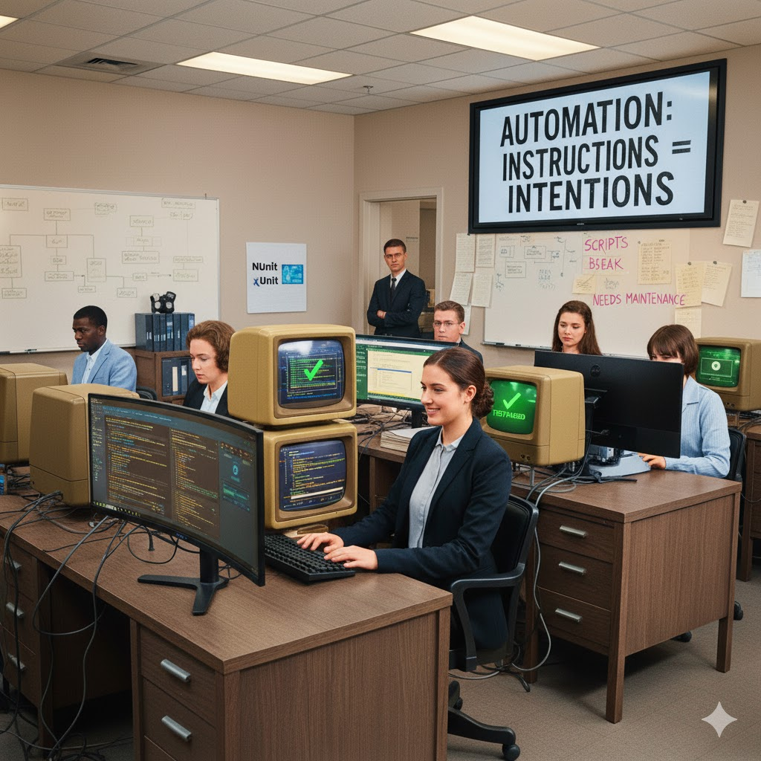
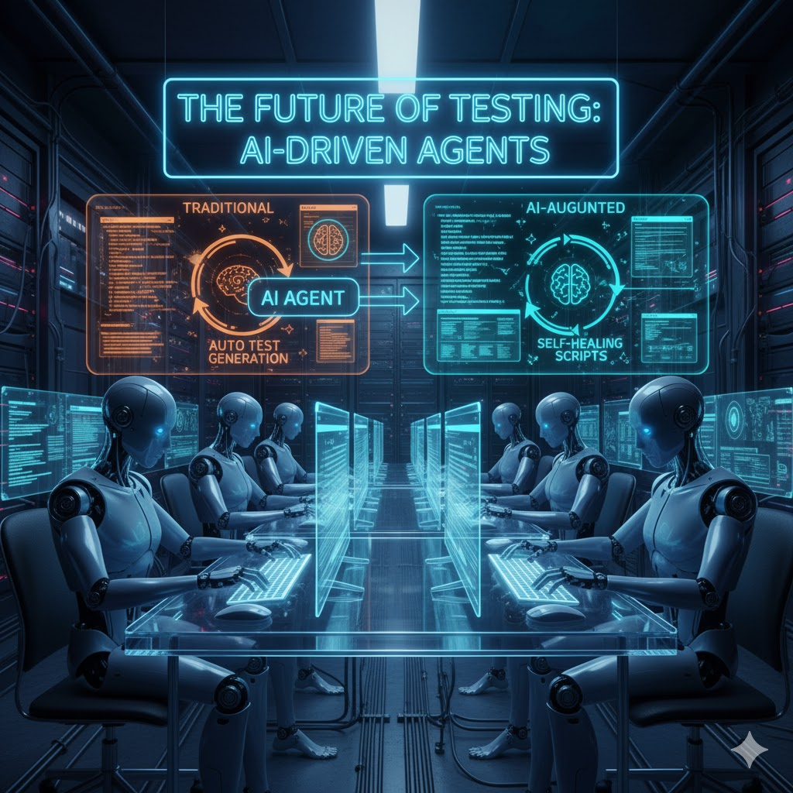
Manual testing
Automation testing
Agentic testing
The endless testing cycle
The Script Maintenance Trap
Toward Intelligent Testing Era

Slide 4





Majdi ZLITNI
Software Consultant
.NET & C# Specialist
majdi-zlitni
majdiz.tn
majdi-Zlitni

Slide 5
Table of contents
01
02
03
04
The Building Blocks of an AI Agent
AI Testing Agent a high-level overview
Microsoft Foundry
Live Demo!

Slide 6
01
The Building Blocks of an AI Agent
(AI)

Slide 7
What's Inside an AI Agent?
LLM (Large Language Model)
RAG (Retrieval-Augmented Generation)
MCP (Model-Context-Protocol): The 'Hands'

Slide 8
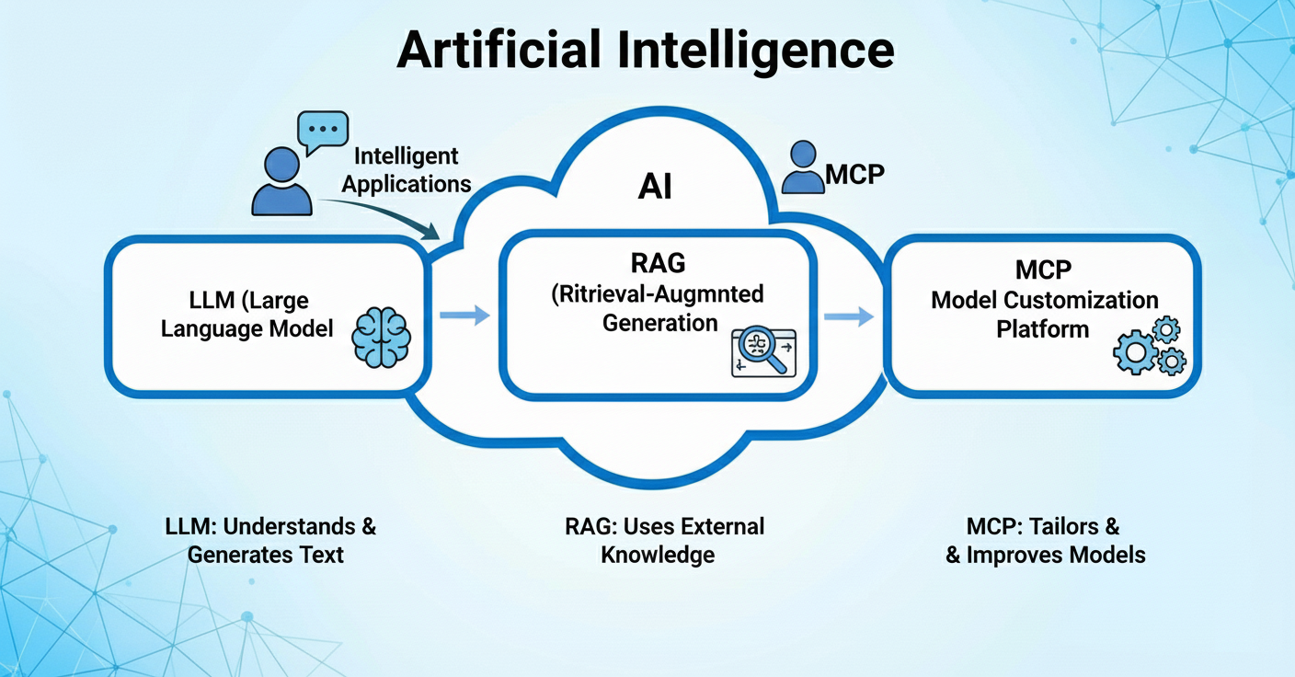

Slide 9
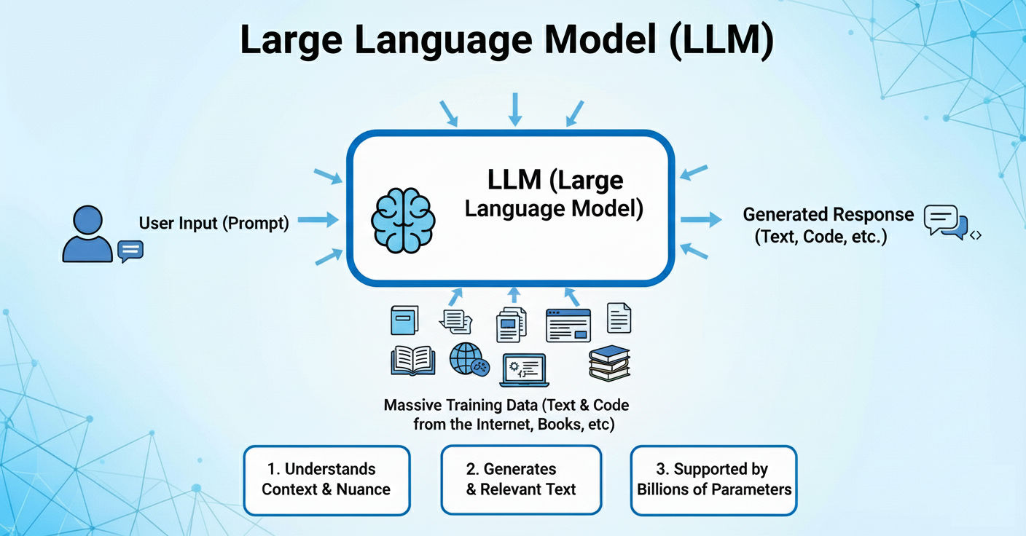

Slide 10
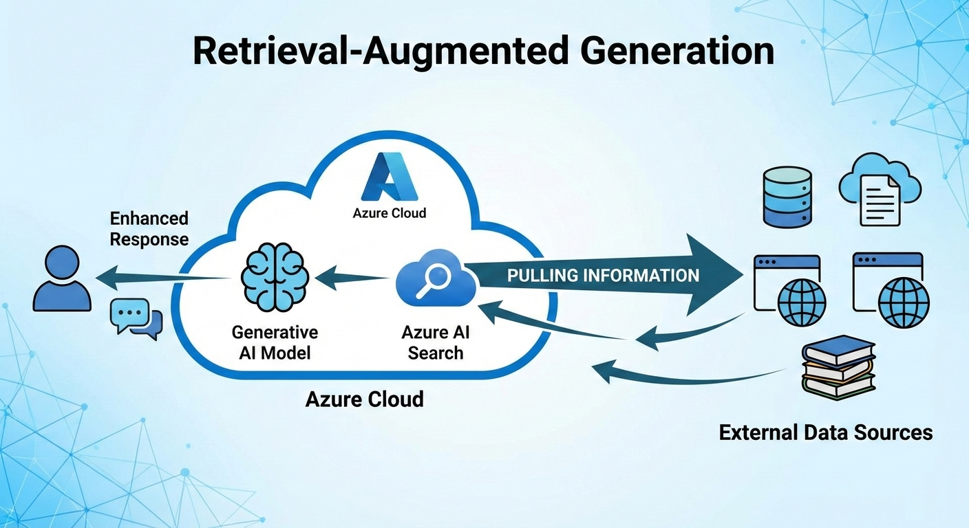

Slide 11
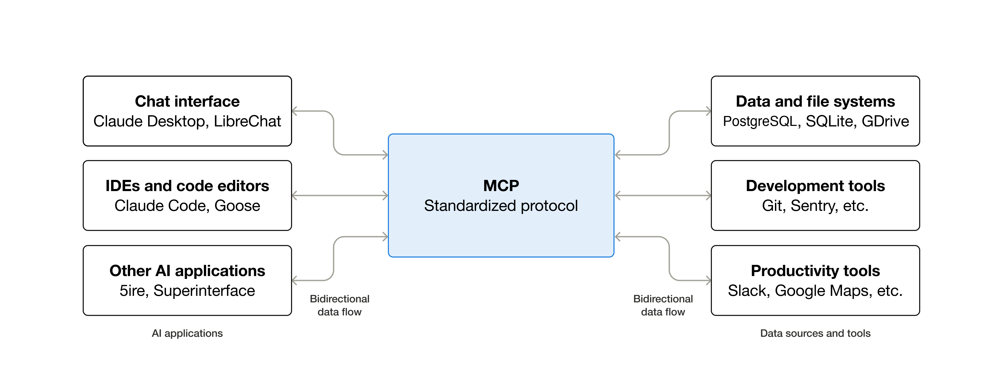

Slide 12
02
AI Testing Agent a high-level overview

Slide 13
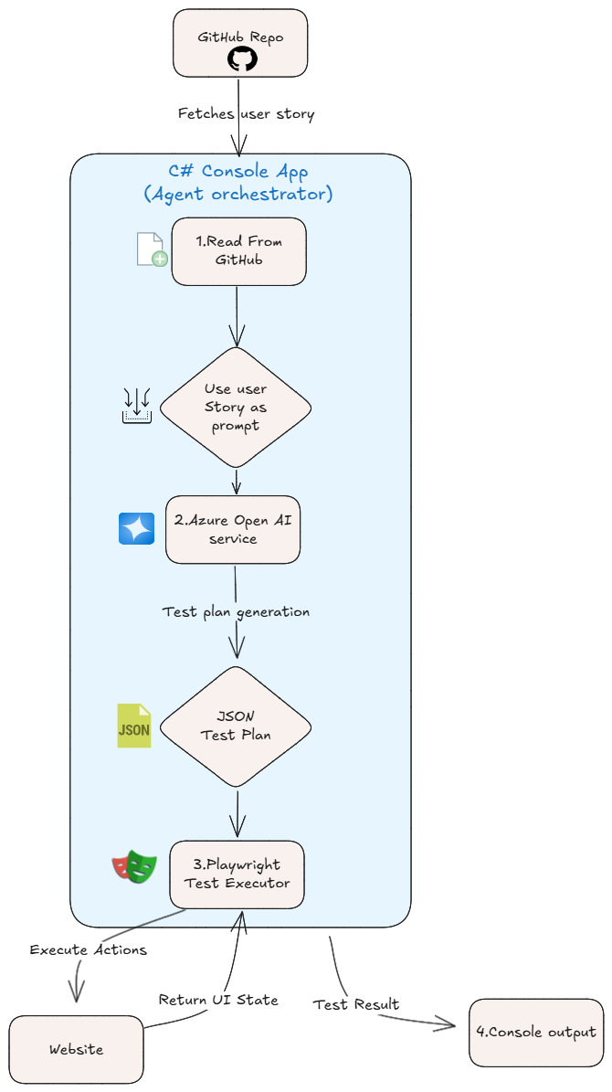
GitHub
Azure Open AI
Playwright
C#

Slide 14
03
Microsoft Foundry

Slide 15
04
Live Demo!

Slide 16
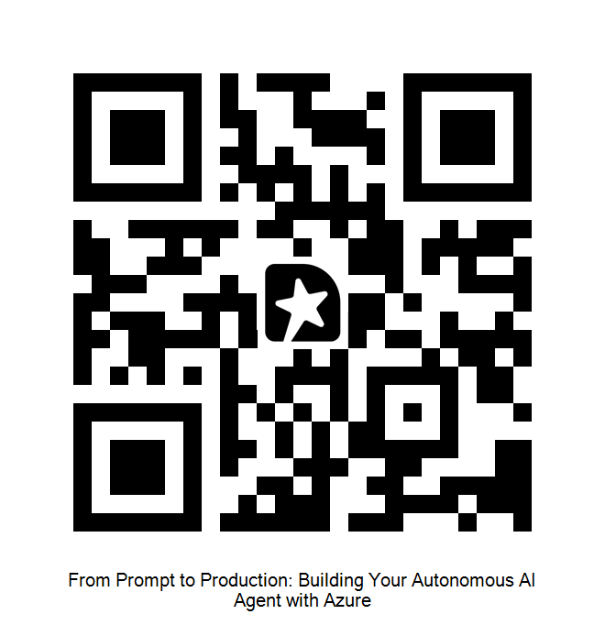
Questions ?​
Notes:
Useful resources https://www.saucedemo.com https://ai.azure.com

